Slide 1
SYLLOGISM

Slide 2
All + All based Venn Diagram
Some + Some based Venn Diagram
All + Some based Venn Diagram
All + No/Some-No based Venn Diagram
Either-Or Based Venn Diagram
Possibility Based Venn Diagram

Slide 3
Statements are given - > Conclusions to be derived There are three relations in syllogism:- 1. Definite relationship- 100% 2. Either and OR - 50-50 % 3. Possibility – chances of occurrence, not sure

Slide 4
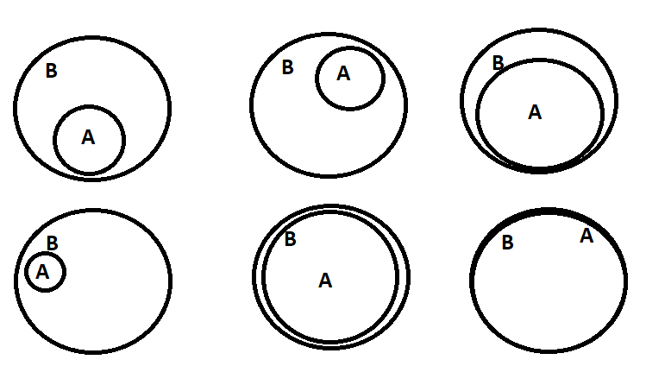
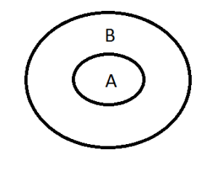
1.) All STATEMENT
All statement is written in the format “ALL A are B”, here A and B represent the subject and object of the statement.
Venn diagram
SYLLOGISM
There are 2 definite conclusions :
All A is B
Some A is B.
Some B is A

Slide 5
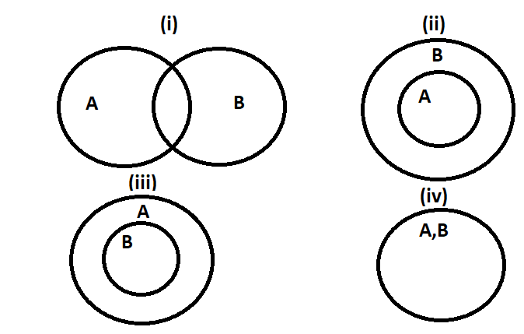
2.) SOME STATEMENT
Some statement is written in the format “Some A are B”, here A and B represent the subject and object of the statement.
There are 2 definite conclusions:
Some A is B
Some B is A

Slide 6
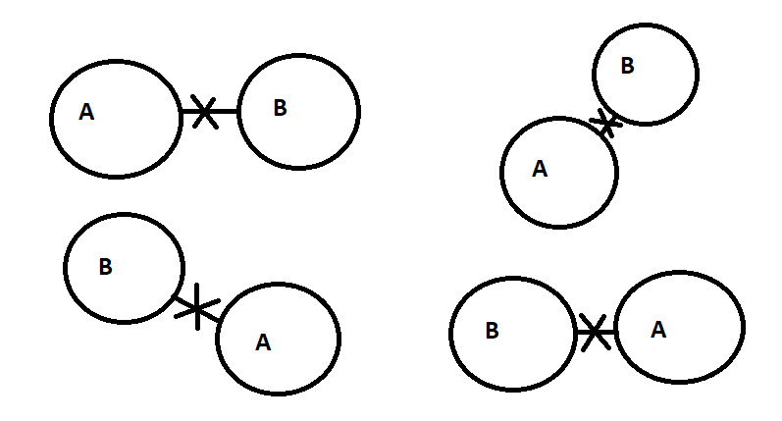
3.) NO STATEMENT
No statement is written in the format “No A are B”, here A and B represent the subject and object of the statement
There are 2 Definite conclusions :
No A is B
No B is A
Some A is not B
Some B is not A

Slide 7
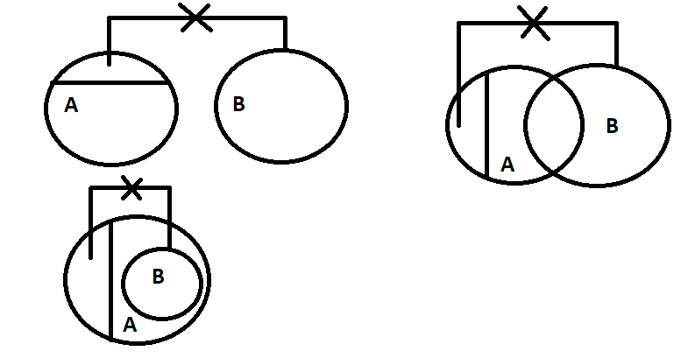
4.) SOME NOT STATEMENT
All statement is written in the format “Some A are not B”, here A and B represent the subject and object of the statement.
There is 1 definite conclusion :
Some A are not B

Slide 8
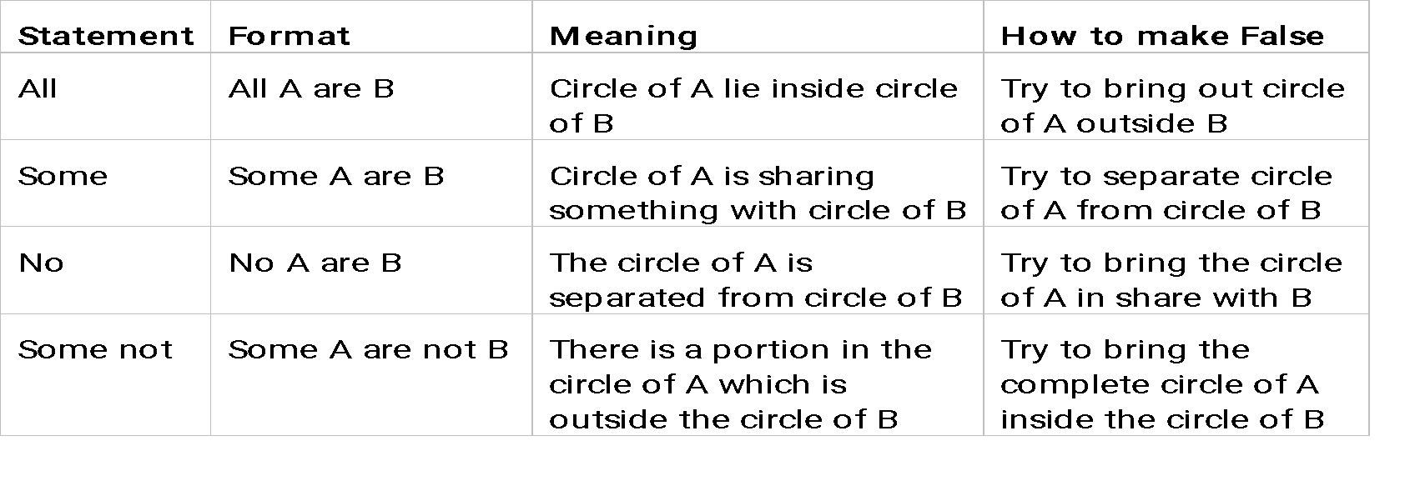

Slide 9
Statements:
All tables are factories.
All pencils are factories.
Conclusions:
I. Some tables are pencils.
II. Some pencils are tables.
A) If only Conclusion I follows
B) If only Conclusion II follows
C) If either Conclusion I or II follows
D) If neither Conclusion I nor II follows
E) If both Conclusion I and II follow
Notes:
Difficulty Level: Easy
Option: D

Slide 10
2. Statements:
All the singers are dancers.
All the dancers are actors.
Conclusions:
I. All the actors are dancers.
II. All the singers are actors.
If only Conclusion I follows
If only Conclusion II follows
If either Conclusion I or II follows
If neither Conclusion I nor II follows
If both Conclusion I and II follow
Notes:
Difficulty Level: Easy
Option: B

Slide 11
3. Statements:
All cars are cycles.
All fans are cycles.
Conclusions:
I. All cars are fans.
II. Some fans are cars
If only Conclusion I follows
If only Conclusion II follows
If either Conclusion I or II follows
If neither Conclusion I nor II follows
If both Conclusion I and II follow
Notes:
Difficulty Level: Easy
Option: D

Slide 12
4. Statements:
All the noodles are chowmien.
All the chowmien are maggi.
Conclusions:
I. All the noodles are maggi.
II. Some chowmien are noodles
If only Conclusion I follows
If only Conclusion II follows
If either Conclusion I or II follows
If neither Conclusion I nor II follows
If both Conclusion I and II follow
Notes:
Difficulty Level: Easy
Option: E

Slide 13
5. Statements:
Some chocolates are brown.
Some candies are chocolates.
Conclusions:
I. Some chocolates are candies.
II. Candy is a brown.
If only Conclusion I follows
If only Conclusion II follows
If either Conclusion I or II follows
If neither Conclusion I nor II follows
If both Conclusion I and II follow
Notes:
Difficulty Level: Easy
Option: A

Slide 14
6. Statements:
Some rubbers are moulds.
Some moulds are wax.
Conclusions:
I. Some rubbers are wax.
II. All moulds are wax.
If only Conclusion I follows
If only Conclusion II follows
If either Conclusion I or II follows
If neither Conclusion I nor II follows
If both Conclusion I and II follow
Notes:
Difficulty Level: Easy
Option: D

Slide 15
7. Statements:
Some stems are roots.
All the roots are mangoes.
Conclusions:
I. All the mangoes are roots.
II. Some stems are mangoes
If only Conclusion I follows
If only Conclusion II follows
If either Conclusion I or II follows
If neither Conclusion I nor II follows
If both Conclusion I and II follow
Notes:
Difficulty Level: Easy
Option: B

Slide 16
8. Statements:
Some almirahs are tables.
All the chairs are tables.
Conclusions:
I. Some tables are chairs.
II. Some tables are almirahs.
If only Conclusion I follows
If only Conclusion II follows
If either Conclusion I or II follows
If neither Conclusion I nor II follows
If both Conclusion I and II follow
Notes:
Difficulty Level: Easy
Option: E

Slide 17
9. Statements:
Some onions are gingers.
All the gingers are potatoes.
Conclusions:
I. Some onions are potatoes.
II. No ginger is onion.
If only Conclusion I follows
If only Conclusion II follows
If either Conclusion I or II follows
If neither Conclusion I nor II follows
If both Conclusion I and II follow
Notes:
Difficulty Level: Easy
Option: A

Slide 18
10. Statements:
Some copies are books.
All books are trees.
Conclusion:
I . Some copies are trees.
II. All trees are books.
If only Conclusion I follows
If only Conclusion II follows
If either Conclusion I or II follows
If neither Conclusion I nor II follows
If both Conclusion I and II follow
Notes:
Difficulty Level: Easy
Option: A

Slide 19
11. Statements:
All phones are calls.
No call is toffee.
Conclusions:
I. No phone is toffee
II. All calls are phones.
If only Conclusion I follows
If only Conclusion II follows
If either Conclusion I or II follows
If neither Conclusion I nor II follows
If both Conclusion I and II follow
Notes:
Difficulty Level: Easy
Option: A

Slide 20
12. Statements:
All trainers are executives.
No executive is an officer.
All officers are managers.
Conclusions:
I. No trainer is an officer.
II. All trainers being managers is a possibility.
If only Conclusion I follows
If only Conclusion II follows
If either Conclusion I or II follows
If neither Conclusion I nor II follows
If both Conclusion I and II follow
Notes:
Difficulty Level: Moderate
Option: E

Slide 21
13. Statements:
No stars is planets.
Some planets are papers.
All papers are glass.
Conclusions:
I. No glass is planet.
II. At least some glasses are planets.
If only Conclusion I follows
If only Conclusion II follows
If either Conclusion I or II follows
If neither Conclusion I nor II follows
If both Conclusion I and II follow
Notes:
Difficulty Level: Moderate
Option: B

Slide 22
14. Statements:
All violins are guitars.
All guitars are beds.
No bed is sofa.
Conclusion:
I. No guitar is sofa.
II. Some violins being sofa is a possibility.
If only Conclusion I follows
If only Conclusion II follows
If either Conclusion I or II follows
If neither Conclusion I nor II follows
If both Conclusion I and II follow
Notes:
Difficulty Level: Moderate
Option: A

Slide 23
15. Statements: All money are mat
Some mat are lion
No lion is a cog
All tigers are cogs
Conclusions:
All money can never be tigers.
All mats can never be cogs
If only Conclusion I follows
If only Conclusion II follows
If either Conclusion I or II follows
If neither Conclusion I nor II follows
If both Conclusion I and II follow
Notes:
Difficulty Level: Expert
Option: B

Slide 24
16. Statement:
Some cars are houses.
Some houses are planes.
Conclusion:
I. Some planes are cars .
II. No plane is car.
A) If only Conclusion I follows
B) If only Conclusion II follows
C) If either Conclusion I or II follows
D) If neither Conclusion I nor II follows
E) If both Conclusion I and II follow
Notes:
Difficulty Level: Moderate
Option: C

Slide 25
17. Statements:
All flowers are trees.
Some trees are horses.
Conclusions:
I. Some horses are flowers.
II. No horse is flower.
If only Conclusion I follows
If only Conclusion II follows
If either Conclusion I or II follows
If neither Conclusion I nor II follows
If both Conclusion I and II follow
Notes:
Difficulty Level: Easy
Option: C

Slide 26
18. Statements:
All schools are lions.
Some birds are schools.
All pencils are lions.
Conclusions:
I. No pencil is bird .
II. Some pencils are birds.
If only Conclusion I follows
If only Conclusion II follows
If either Conclusion I or II follows
If neither Conclusion I nor II follows
If both Conclusion I and II follow
Notes:
Difficulty Level: Expert
Option: C

Slide 27
19. Statements: All baskets are marbles.
Some marbles are sticks.
No stick is garden.
Conclusions:
I. Some gardens are basket.
II. Some Sticks are baskets.
III. No garden is basket.
If only Conclusion I follows
If only Conclusion III follows
If either Conclusion I or III follows
I f either Conclusion I or II follows
If both Conclusion I and III follow
Notes:
Difficulty Level: Expert
Option: C

Slide 28
20. Statements: All stones are hammers. No hammer is ring.
Some rings are door.
All doors are windows. Conclusions: I. Some windows are stones. II. Some windows are rings.
III. No window is stone.
IV. Some rings are stones.
If only Conclusion I follows
If only Conclusion II follows
If conclusion II and either Conclusion I or III follows
If conclusion III and either Conclusion I or II follows
If both Conclusion I and II follow
Notes:
Difficulty Level: Expert
Option: C

Slide 29
21. Statements:
All bats are copy. Some bats are chairs.
Conclusions:
I. There is a possibility that All bats are not copy. II. There is a possibility that Some bats are chairs.
If only Conclusion I follows
If only Conclusion II follows
If either Conclusion I or II follows
If neither Conclusion I nor II follows
If both Conclusion I and II follow
Notes:
Difficulty Level: Easy
Option: D

Slide 30
22. Statements:
Some dogs are lions.
Some lions are cats.
Conclusions:
I. All dogs are cats is a possibility.
II. Some lions are not dog is a possibility.
If only Conclusion I follows
If only Conclusion II follows
If either Conclusion I or II follows
If neither Conclusion I nor II follows
If both Conclusion I and II follow
Notes:
Difficulty Level: Moderate
Option: E

Slide 31
23. Statements:
All Tiers are Liars
Some Liars are LED.
Conclusions:
I. Some LED are Tiers.
II. All Tiers being LED is a possibility.
If only Conclusion I follows
If only Conclusion II follows
If either Conclusion I or II follows
If neither Conclusion I nor II follows
If both Conclusion I and II follow
Notes:
Difficulty Level: Easy
Option: B

Slide 32
24. Statements:
Some mails are cats.
All dates are cats.
Conclusions:
I. All mails being dates is a possibility.
II. No dates is a mail.
If only Conclusion I follows
If only Conclusion II follows
If either Conclusion I or II follows
I f neither Conclusion I nor II follows
If both Conclusion I and II follow
Notes:
Difficulty Level: Easy
Option: A

Slide 33
25. Statements: Some friends are enemies
All enemies are black
Some black are whites
Conclusions: 1. All friends being black is a possibility.
2. All such friends that are not black can be enemies.
3. Some enemies are whites.
4. All whites are black is a possibility.
None follows
Only I follows
Only II follows
Only III follows
Only I and IV follow
Notes:
Difficulty Level: Expert
Option: E

Slide 34
26. Statements: All reds are blues
Some white are blue
Some white are not ten
No black is blue.
Conclusions: I. Some white which are blue are also ten is a possibility
II. Some black are not red
III. Every red is ten
IV. Some blue which are reds are also ten is a possibility
Only I and III are follow
Only I, II and IV are follow
Only II and IV are follow
Only I follows
Only I and either II or IV follow
Notes:
Difficulty Level: Expert
Option: B

Slide 35
27. Statements:
Some mats are calls.
All pens are calls.
Some erasers are pens.
Conclusions:
I. Some calls are not mats is a possibility.
II. Some calls are erasers.
If only Conclusion I follows
If only Conclusion II follows
If either Conclusion I or II follows
If neither Conclusion I nor II follows
If both Conclusion I and II follow
Notes:
Difficulty Level: Moderate
Option: E

Slide 36
28. Statements: All pens are clocks.
Some clocks are tyres.
Some tyres are wheeels.
Some wheels are buses.
Conclusions: I. Some buses are tyres.
II. Some wheels are clocks.
III. Some wheels are pens.
IV. Some buses are clocks.
If only Conclusion I follows
If only Conclusion II follows
If either Conclusion I or II follows
None follows
If both Conclusion I and II follow
Notes:
Difficulty Level: Expert
Option: D

Slide 37
29. Statements: Some books are papers.
Some papers are roads.
Some roads are lanes.
Some lanes are streets.
Conclusions: I. Some streets are not roads.
II. All lanes being books is a possibility.
III. All streets being paper is a possibility.
IV. Some roads are definitely books.
If only Conclusion I follows
If only Conclusion III follows
If either Conclusion I or III follows
None follows
If both Conclusions II and III follow
Notes:
Difficulty Level: Expert
Option: E

Slide 38
30. Statements: All axes are scissors.
Some scissors are blades.
Some blades are sickles.
No sickle is an axe.
Conclusions:
Some sickles can be scissors.
All sickles are blades.
If only Conclusion I follows
If only Conclusion III follows
If either Conclusion I or III follows
None follows
If both Conclusions II and III follow
Notes:
Difficulty Level: Moderate
Option: A

Slide 39

Any Doubts…

